Slide 1

THE ASAM Appropriate Use of Drug Testing in Clinical Addiction Medicine WEBINAR
Louis E. Baxter, Sr., MD, DFASAM

Slide 2
The ASAM Appropriate Use of Drug Testing in Clinical Addiction Medicine Webinar
July 19, 2017
Louis E. Baxter, Sr., MD, DFASAM
No disclosures

Slide 3

PRESENTATION OUTLINE
Why Do We Need This Consenus Document?
Context
Document Development
How to Use The Document
Principles of Drug Testing
Process of Drug Testing
Biological Matrices
Settings
Special Populations
Common Clinical Questions
Additional Information About Drug Testing

Slide 4
WHY DO WE NEED THIS CONSENSUS DOCUMENT?

Slide 5

Until now, there has been no specific guidance about how to effectively utilize drug testing in clinical settings to help identify, treat, and support the recovery of patients with addictions.

Slide 6

Clinicians need guidance. Currently, there is a lack of understanding of methodological limitations, interpretation, and application of drug test results among clinicians.

Slide 7

Clinical decisions related to drug tests are made every day.
Even in the context of limited information about how best to apply this tool, providers and payers use it to make decisions about what kind of care patients should and do receive.

Slide 8

Drug testing can be a powerful technology for supporting recovery.

Slide 9
CONTEXT

Slide 10

Historically, drug testing in addiction treatment has been wielded as a tool for control and punishment.

Slide 11
There has been a tug-of-war between fraudulent practices and restrictive insurance policies.
Examples of Practices
Testing for an arbitrary, large number of drugs
Testing with unnecessary frequency
Using expensive confirmatory test methods on every sample
Examples of Policies
Arbitrary restrictions on the frequency of drug tests
Inability to order more than one test in a day
Refusal to reimburse for more accurate drug testing methods

Slide 12
New drugs, drug use patterns, and drug testing technology have made clinical decision-making more complicated.
Synthetic Drugs
Cathinones
Synthetic cannabinoids
Synthetic opioids
Patterns
Rx drug misuse
Polydrug use
Opioids
Drug Testing Technology
Biological matrices
Point-of-Care Tests
Sophisticated lab tests

Slide 13
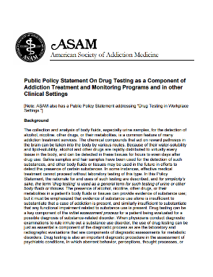
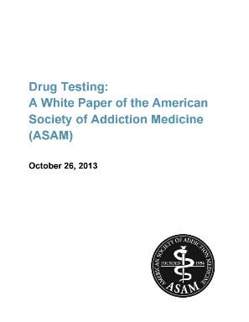
ASAM has worked for a number of years on this issue.
However, ASAM has not previously released specific clinical guidance about appropriate drug testing practices.

Slide 14
The 2013 White Paper introduced the concept of “smarter” drug testing.
Some elements of smarter drug testing
Increased use of random drug testing
Using other matrices in addition to urine
Testing for specific drugs based on the individual and his/her community, instead of the same test panel for every patient
Better collection strategies to avoid sample tampering
Careful consideration of financial cost balanced against value and medical necessity
This consensus document is a step to help providers engage in smarter drug testing.

Slide 15
DOCUMENT DEVELOPMENT

Slide 16
ASAM’s Quality Improvement Council (QIC) was the oversight committee for the development of the document.
Other participants included:
Institute for Research, Education and Training in Addictions
Provided research and technical assistance
Multidisciplinary Expert Panel
Rated appropriateness of clinical practices
Addiction Providers, Other Experts, Community Members
Submitted comments through external review

Slide 17
The document was developed using a method based on the RAND/UCLA Appropriateness Method.
Summary of Methodology
1
2
3
4
Literature review produces hypothetical clinical statements
Expert panelists individually rate statements’ appropriateness
Expert panelists meet face-to-face to discuss disagreements
Expert panelists re-rate statements
Note: Expert panelists considered both empirical evidence and clinical experience when rating appropriateness statements.

Slide 18
Expert Panel included:
Variety of specialties
Allopathic and osteopathic
Range of practice settings
A multidisciplinary panel is recommended as part of the RAND/UCLA Appropriateness Method.

Slide 19
Expert Panel Members (in alphabetical order)
Louis Baxter, MD, DFASAM
Lawrence Brown, MD, MPH, DFASAM
Matthew Hurford, MD, Expert Panel Moderator
William Jacobs, MD
Kurt Kleinschmidt, MD
Marla Kushner, DO, FASAM
Lewis Nelson, MD
Michael Sprintz, DO, FASAM
Mishka Terplan, MD, MPH, FASAM
Elizabeth Warner, MD
Timothy Wiegand, MD, FACMT, FAACT, FASAM

Slide 20
External reviewers included representatives from:
American Academy of Pediatrics
American Association for the Treatment of Opioid Dependence
American College of Medical Toxicology
American Congress of Obstetricians and Gynecologists
National Association of Drug Court Professionals
Substance Abuse and Mental Health Services Administration
        …and many more organizations.

Slide 21
HOW TO USE THE DOCUMENT

Slide 22
The primary audience for the document are providers who utilize drug testing in clinical settings.
“
Providers are encouraged to utilize this consensus document to improve their quality of care, recognizing that it will be necessary to seek supplemental information when questions arise that this document does not comprehensively address.
Healthcare administrators in residential, outpatient and other settings should reference this document as a guide for appropriate practice related to drug testing. This document may inform policy decisions related to establishing or improving a drug testing program in a variety of clinical settings.
”

Slide 23
Payers may use the document as a reference, but it is not designed to translate directly to payer policies.
“
It would be inappropriate to translate the statement that ‘during the initial phase of treatment, drug testing should be at least weekly’ into a payer policy that will not reimburse drug tests that are more frequent than weekly.
”

Slide 24
PRINCIPLES OF DRUG TESTING

Slide 25

Key principle: Providers should understand that drug tests are designed to measure whether a particular substance has been used within a particular window of time.

Slide 26

Drug test results cannot…
Prove that substance use has not occurred
Identify every possible substance that may have been used
Rule out an SUD
Diagnose an SUD

Slide 27

Other principles of drug testing:
Combined with a patient's self-report
Used as a therapeutic tool
Performed at intake to assist in a patient's initial assessment and treatment planning
Used to monitor recent substance use in all addiction treatment settings
Used to monitor the effectiveness of a patient’s treatment plan

Slide 28
PROCESS OF DRUG TESTING

Slide 29
Presumptive and Definitive Tests
Technology
Immunoassay
Various chromatography and mass spectrometry techniques
Capability
Sensitivity
Specificity
Common model
Screen with immunoassays
Confirm with a more specific test to rule out false-positives

Slide 30

Presumptive Tests
Should be routine
Used when it is a priority to have more immediate (although less accurate results)
Not always necessary to use a confirmatory test if patient confirms that he or she used a substance detected by a presumptive test

Slide 31

Definitive Tests
Whenever a provider wants to:
  Detect specific substances not targeted by presumptive tests
  Quantify levels of the substance present
  Refine the accuracy of the results
When the results inform clinical decisions with major clinical or non-clinical implications for the patient
If a patient disputes the findings of a presumptive test
Consider if presumptive test results are negative, but the patient exhibits signs of relapse

Slide 32
Attach a meaningful therapeutic response to test results, both positive and negative, and deliver it to patients as quickly as possible.
Positive presumptive test results
Speak with the patient
Review all medications, herbal products, foods, and other potential causes of positive results
Seek definitive testing if the patient denies substance use
Positive definitive test result
Consider intensifying treatment or adding adjunctive treatments
Suspected inaccurate results
Consider repeating the test, changing the test method, changing/adding to the test panel, adding specimen validity testing, or using a different matrix

Slide 33

Frequency of testing should be dictated by patient acuity and level of care.
Frequency
Initial phase of treatment: at least weekly
Stable in treatment: at least monthly (with consideration for less frequent testing)
Randomness
When possible, testing should occur on a random schedule
A random-interval schedule is preferable to a fixed-interval schedule

Slide 34
BIOLOGICAL MATRICES

Slide 35
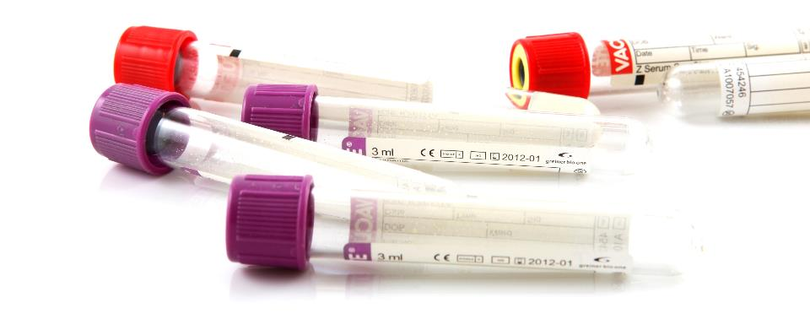
Using Various Matrices
Urine, blood, exhaled breath, oral fluid (saliva), sweat and hair
“Smarter” drug testing can mean using more than one matrix
Important to understand the advantages and disadvantages of each matrix

Slide 36
Matrix Considerations
Window of detection
Time to obtain results (availability of POCT)
Ease of collection (need for trained personnel, collection facilities)
Invasiveness/unpleasantness of collection
Availability of the sample (e.g., renal health, shy bladder, baldness, dry mouth)
Susceptibility of the sample to tampering

Slide 37
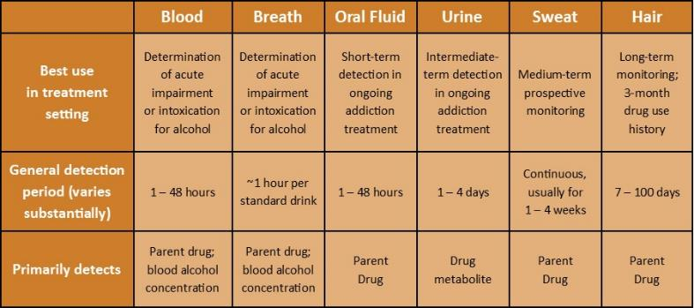
Information about matrices’ windows of detection and utility in addiction treatment

Slide 38
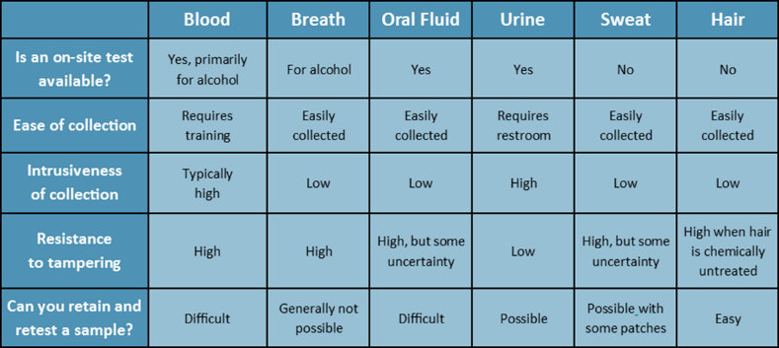
Additional considerations for each matrix

Slide 39

Urine
Most well-established and well-supported matrix
Most prone to tampering

Slide 40
Oral Fluid
Appropriate for presumptive testing, but does not have nearly such an extensive body of research behind it as urine
Shorter window of detection than urine (12-48 hours for most substances)
Advantages include:
  Unobtrusively collected
  Does not require the same staff and bathroom facility resources
  So far, does not suffer from the same sample tampering problems that urine has

Slide 41
SETTINGS and LEVELS OF CARE

Slide 42
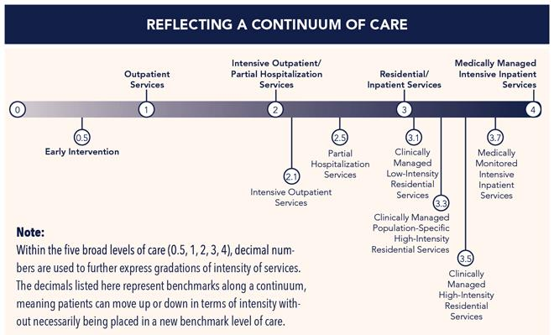
The ASAM Criteria describes the continuum of addiction services using five broad levels of care.

Slide 43

Very little research has examined optimal drug testing practices specific to ASAM levels of care.

Slide 44

Levels of Care
Outpatient: opportunity for substance use is greater
Residential: importance of a drug-free therapeutic environment

Slide 45

Opioid Treatment Services
Purposes include:
Detecting substance use
Monitoring medication adherence
Monitoring possible diversion
Consider increasing drug testing frequency during tapering and in the period after tapering
Providers should understand metabolic pathways of commonly prescribed opioids

Slide 46

Opioid Treatment Programs
Eight times per year should be a minimum
Unexpected test results can lead to discontinuation or reduction of take home doses of medication

Slide 47

Office-Based Opioid Treatment
Frequency should be at least monthly, unless otherwise clinically indicated. Patients who are stable in their recovery may require less frequent testing.
Frequent office visits, Prescription Monitoring Programs, observed dosing, and medication counts can also help address diversion

Slide 48

Recovery Residences
Weekly random drug testing is appropriate
If expelled, patients should be able to continue an ongoing therapeutic relationship with outpatient addiction treatment provider(s)

Slide 49
SPECIAL POPULATIONS

Slide 50

Adolescents
Document addresses general healthcare settings
Drug testing can be used for early identification of substance use
Drug testing can be used to monitor adolescents in addiction treatment or recovery from an SUD
Providers should not encourage the use of home drug testing
Testing without consent is not appropriate, except in emergency situations (e.g., accidents, suicide attempts, seizures)

Slide 51

Pregnant Patients
Document addresses general healthcare settings
Be aware of the adverse legal and social consequences of detecting substance use among pregnant women
Be familiar with local and state reporting requirements before conducting a drug test and relay this information to their patient before conducting a drug test
Comprehensive substance use assessment, which may include drug testing, is part of obstetrical best practices.
Providers working with this population should learn about and appropriately use clinical laboratory tests.

Slide 52

People in Recovery
Appropriate to conduct drug testing for a minimum of five years in healthcare settings
Appropriate frequency depends on the severity and chronicity of the patient's addiction

Slide 53

Health and Other Professionals
Drug testing is especially useful for individuals in recovery who have increased access to psychoactive substances, including healthcare professionals and professionals in safety sensitive positions

Slide 54
COMMON CLINICAL QUESTIONS

Slide 55

What about patients who are stable on buprenorphine? Should they still be tested regularly?

Slide 56
May be tested less frequently than once a month
Frequency may be adjusted according to a provider’s clinical judgment

Slide 57
How can I offer random testing to a patient I see once a week or once a month?

Slide 58
When random, unannounced testing is not feasible, scheduled testing is appropriate.

Slide 59
How can I provide quality care for pregnant patients without putting them at legal risk?

Slide 60
Stakes for drug testing are increased for this population
ASAM recommends explicit written consent for drug testing, including during labor and delivery
See 2017 ASAM Policy Statement, “Substance Use, Misuse, and Use Disorders During and Following Pregnancy, with an Emphasis on Opioids”

Slide 61
If a patient has repeated positive drug tests, how can I address it in a therapeutic, non-punitive manner?

Slide 62
If drug testing results contradict self-reports, therapeutic discussions should take place
Discussions with patients should be non-confrontational
Repeated positive test results indicate that the treatment plan needs to be adjusted

Slide 63
I feel like I’m always playing catch-up. Synthetic drugs keep appearing and drug use patterns keep changing. How do I keep up?

Slide 64
Providers are always playing catch-up when it comes to designer drugs and sample tampering strategies.

Slide 65
We often have questions about choosing testing panels and proper interpretation of results. Where can I get help?

Slide 66
Medical toxicologist
Staff at the testing laboratory
And/or a physician with MRO certification

Slide 67
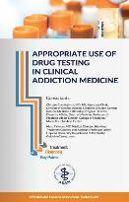
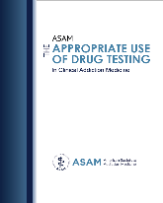
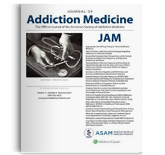
FINDING ADDITIONAL INFORMATION

